Slide 1

Case Study
Erick Hernández

Slide 2
AGENDA
1) Notes on Case Study Rules
4) Model Development
2) Exploratory Data Analysis
5) Model Improvement
3) Feature Engineering
6) Conclusion

Slide 3
1
Notes on case study

Slide 4

Case Study “Prediction of Applications at MoreJobs4Your”
Input data: Information on users and job descriptions.
Goal: Evaluate and predict if a person applied or not to a job position.
Rules …
Notes on Case Study
>
EDA
>
Feature Engineering
>
Model Dev.
>
Model Improvement
>
Conclusion

Slide 5
2
Exploratory data analysis

Slide 6
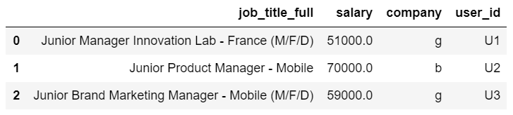
EDA
What can we learn from the dataset?
~70%
Missing
Job Description
User ID
Notes on Case Study
>
EDA
>
Feature Engineering
>
Model Dev.
>
Model Improvement
>
Conclusion

Slide 7
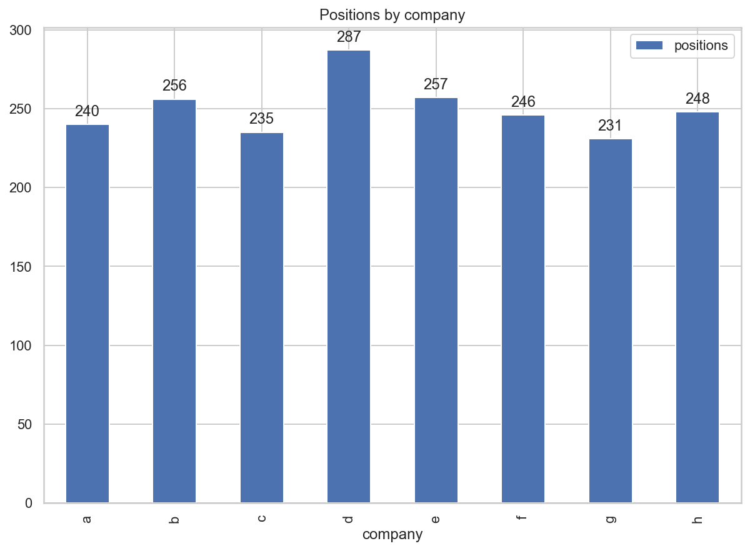
EDA
What can we learn from the dataset?
Good balance
Notes on Case Study
>
EDA
>
Feature Engineering
>
Model Dev.
>
Model Improvement
>
Conclusion

Slide 8
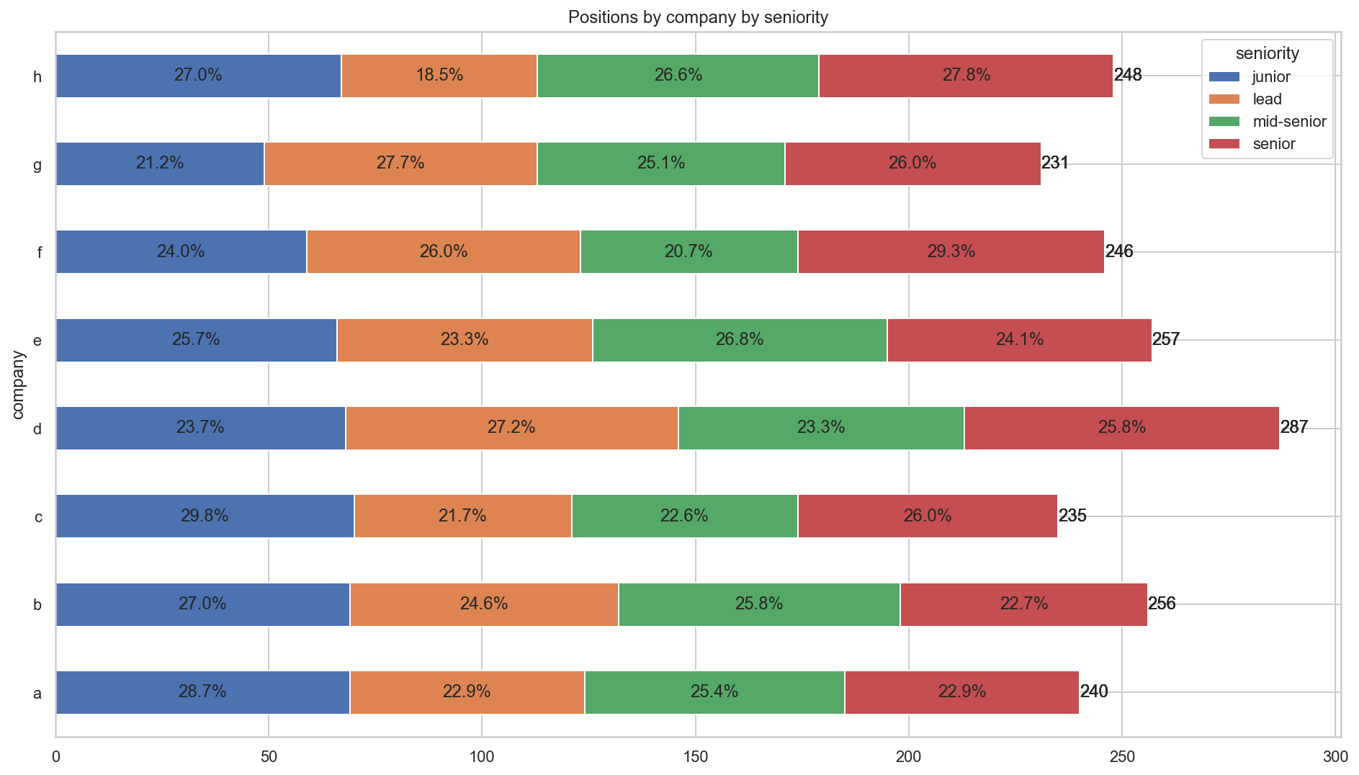
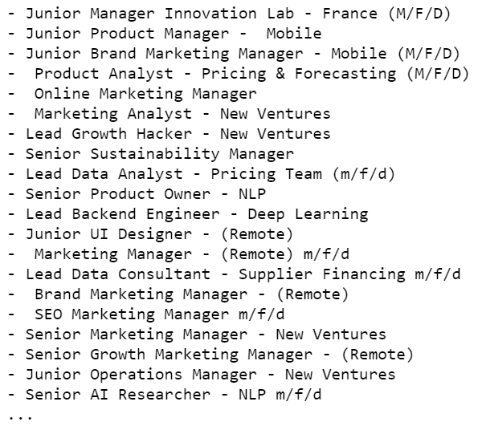
EDA
Good balance
What can we learn from the dataset?
Notes on Case Study
>
EDA
>
Feature Engineering
>
Model Dev.
>
Model Improvement
>
Conclusion

Slide 9
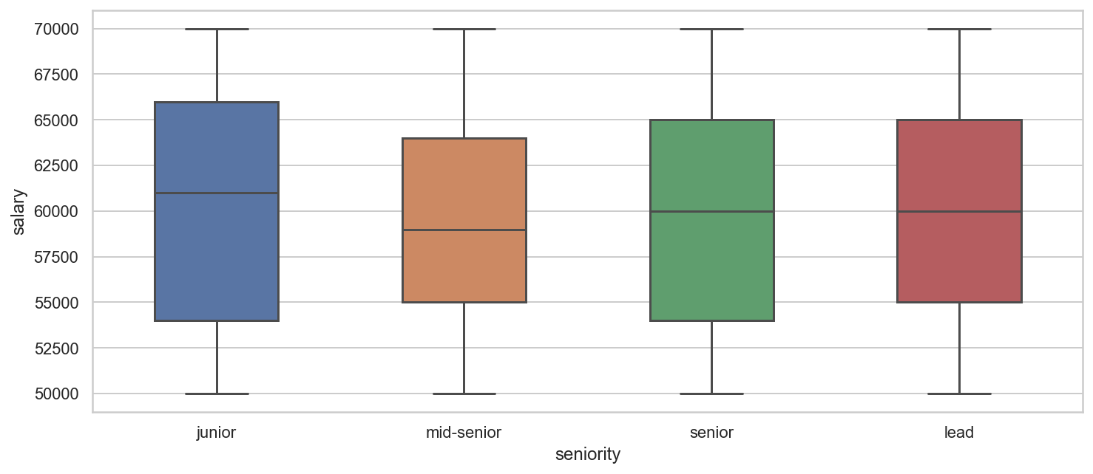
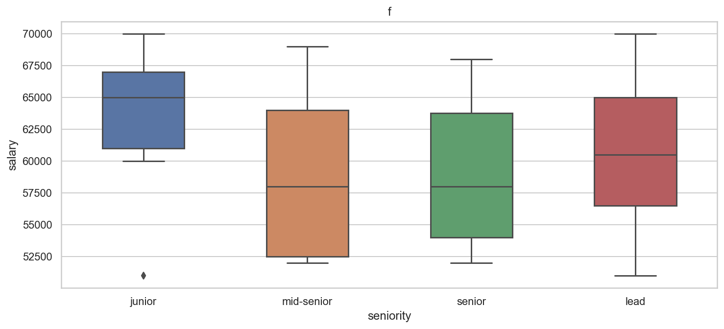
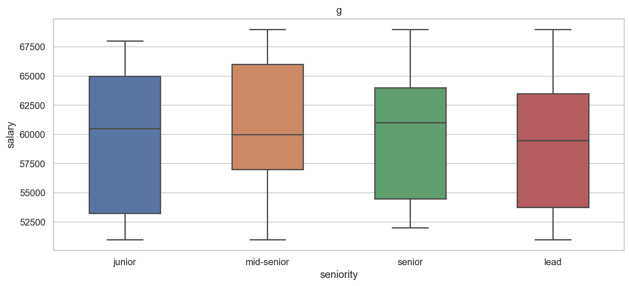
EDA
What can we learn from the dataset?
Junior > Lead ?
By Seniority
By Company by seniority
Notes on Case Study
>
EDA
>
Feature Engineering
>
Model Dev.
>
Model Improvement
>
Conclusion

Slide 10
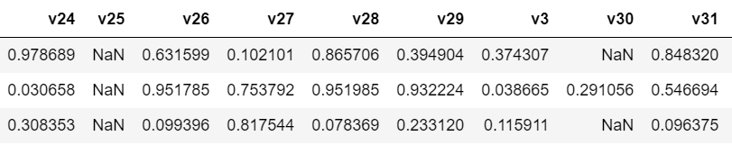
EDA
What can we learn from the dataset?
~70%
Missing
~70%
Missing
Notes on Case Study
>
EDA
>
Feature Engineering
>
Model Dev.
>
Model Improvement
>
Conclusion

Slide 11
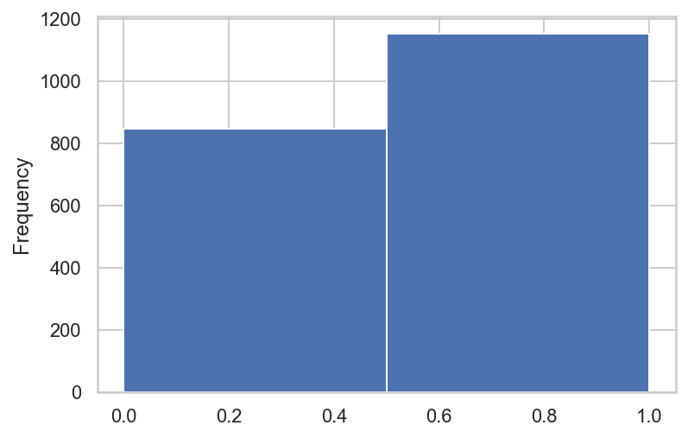
EDA
What can we learn from the dataset?
Balanced? … it’s ok
Distribution of Target Variable
Notes on Case Study
>
EDA
>
Feature Engineering
>
Model Dev.
>
Model Improvement
>
Conclusion

Slide 12
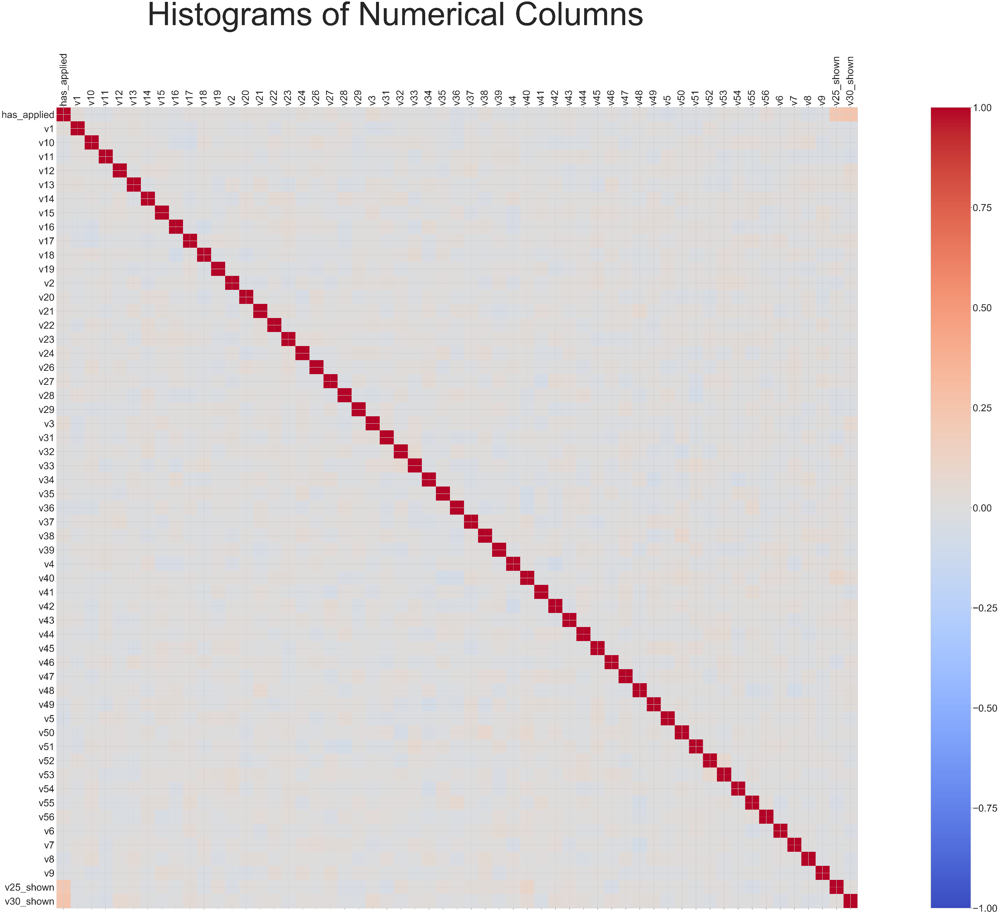
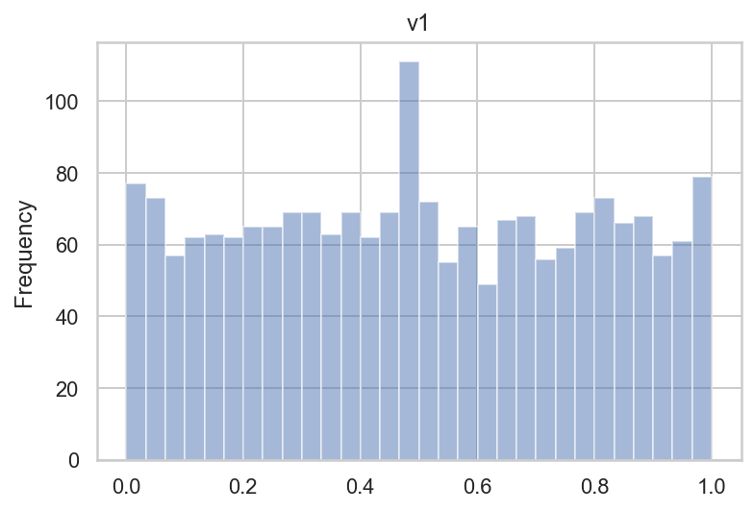
EDA
What can we learn from the dataset?
Variables correlation
Correlation with target variable?
Similar distribution
Distribution of variables
Notes on Case Study
>
EDA
>
Feature Engineering
>
Model Dev.
>
Model Improvement
>
Conclusion

Slide 13
3
Feature engineering

Slide 14
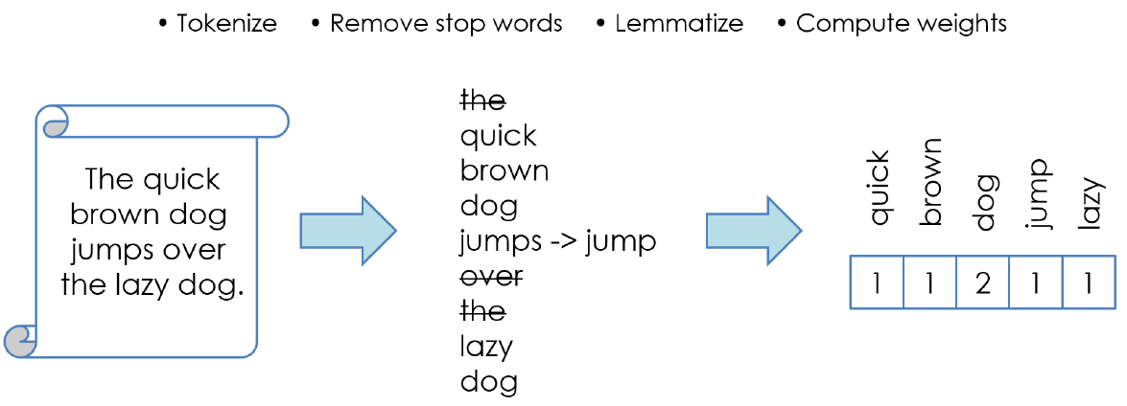
Handling text – Bag of words

Slide 15
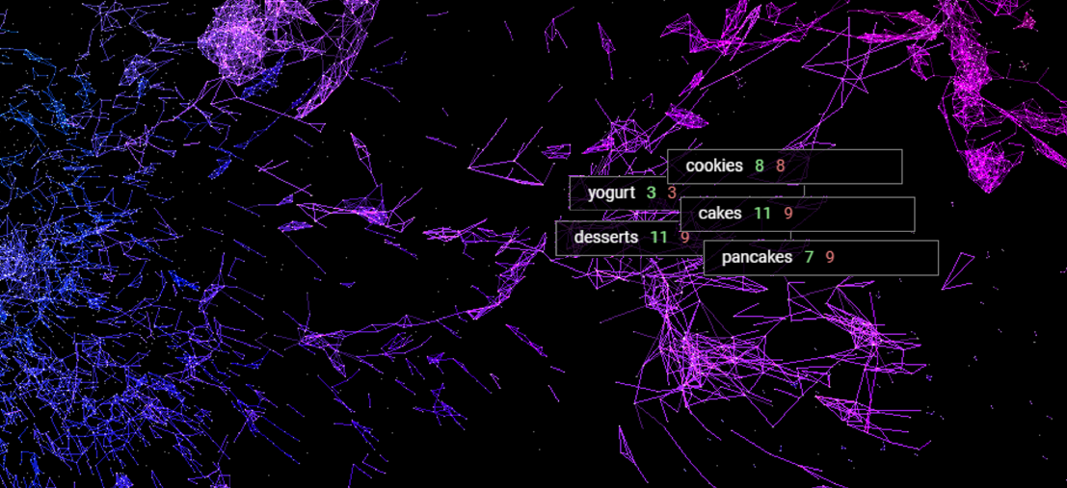
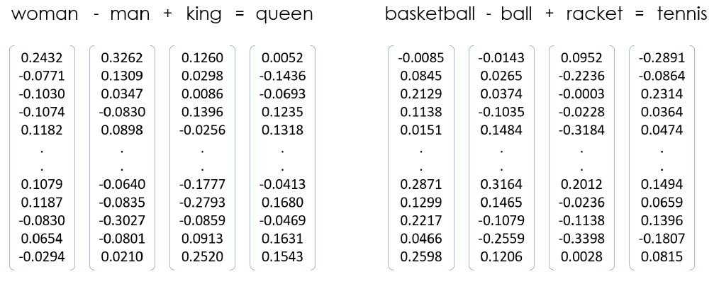
Handling text – Word Embedding

Slide 16
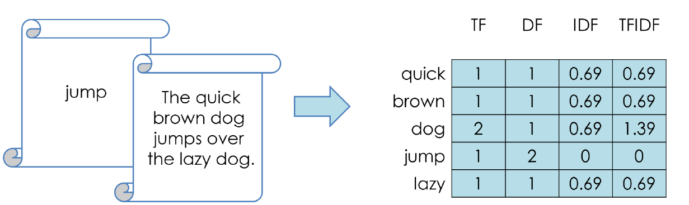
Handling text – TF-IDF

Slide 17
Feature Engineering
Salary
Binary
Salary_shown
Category
K-1 dummies
Mid-senior
. . .
lead
Company
K-1 dummies
Company_b
. . .
Company_h
Job Title
Length
Title_length
TF-IDF
0
. . .
100
V25 and v30
Binary
V25_shown
V30_shown
Notes on Case Study
>
EDA
>
Feature Engineering
>
Model Dev.
>
Model Improvement
>
Conclusion

Slide 18
4
Model development

Slide 19
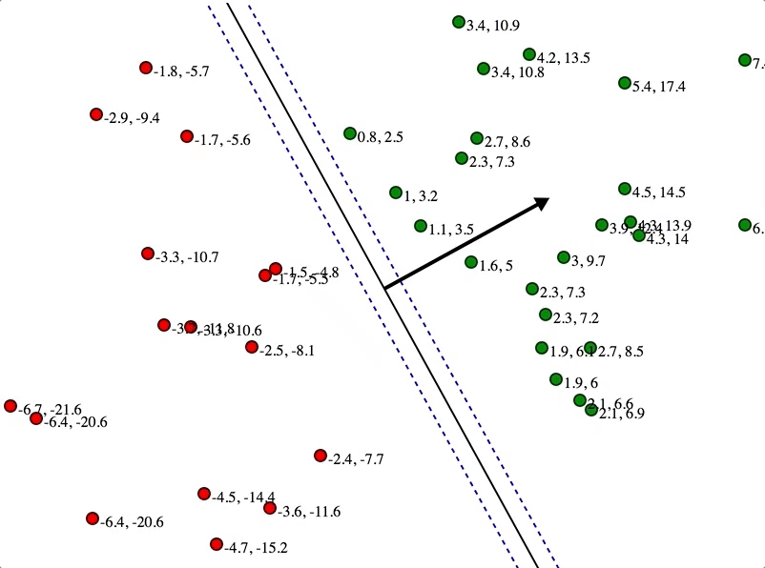
Model Development
Sklearn Classifiers:
SVM
Logistic Regression
Random Forest Classifier
Extra Trees Classifier
AdaBoost Classifier
Gradient Boosting Classifier
AUC = 0.81
Image: https://jeremykun.files.wordpress.com/2017/06/svm_solve_by_hand-e1496076457793.gif?w=558&zoom=2
Notes on Case Study
>
EDA
>
Feature Engineering
>
Model Dev.
>
Model Improvement
>
Conclusion

Slide 20
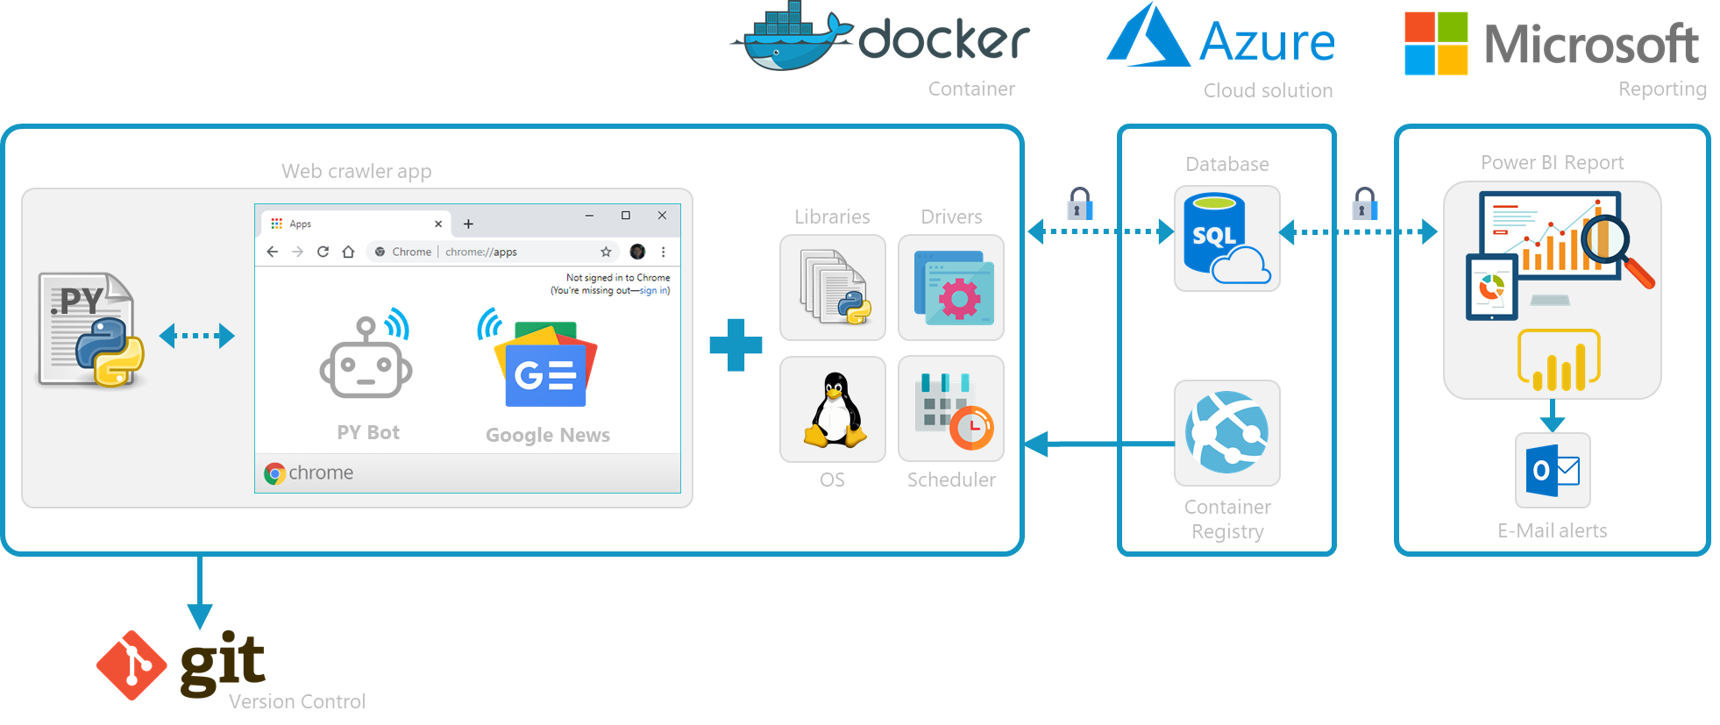

Technical design
Notes on Case Study
>
EDA
>
Feature Engineering
>
Model Dev.
>
Model Improvement
>
Conclusion

Slide 21
5
Model improvement

Slide 22
Model Development
Grid search for:
SVM
Logistic Regression
Random Forest Classifier
Extra Trees Classifier
AdaBoost Classifier
Gradient Boosting Classifier
AUC 0.812 -> 0.856
Image: https://jeremykun.files.wordpress.com/2017/06/svm_solve_by_hand-e1496076457793.gif?w=558&zoom=2
Notes on Case Study
>
EDA
>
Feature Engineering
>
Model Dev.
>
Model Improvement
>
Conclusion

Slide 23
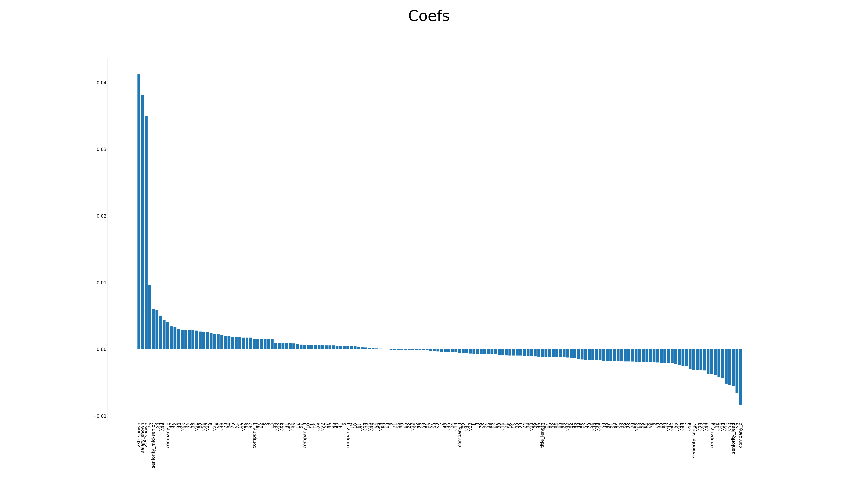
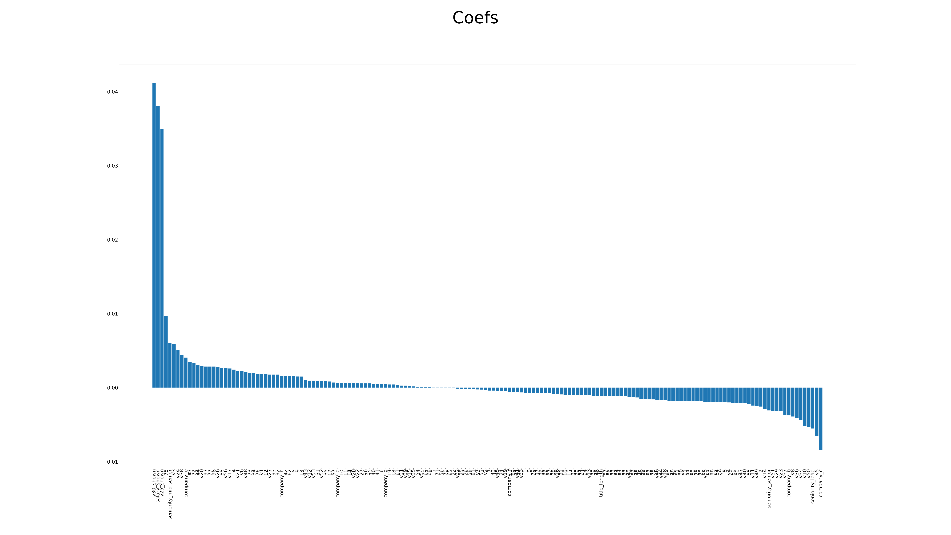
Coefficients
Notes on Case Study
>
EDA
>
Feature Engineering
>
Model Dev.
>
Model Improvement
>
Conclusion

Slide 24
6
Conclusion

Slide 25
Goal
What did we achieve?
1) Understood the data
2) Developed a model to estimate the „has_applied“ label
3) Understood what are the drivers
What can be done? …
Notes on Case Study
>
EDA
>
Feature Engineering
>
Model Dev.
>
Model Improvement
>
Conclusion

Slide 26
Q&A

Slide 27
Thank you

Slide 28
Data is the new oil. It’s valuable, but if unrefined it cannot really be used. It has to be changed into gas, plastic, chemicals, etc. to create a valuable entity that drives profitable activity; so must data be broken down, analyzed for it to have value.
“
”
- Clive humby

